Slide 1


OPTIMIZING YOUR INVENTORY FOR EFFICIENCY AND PROFITABILITY
INTEGRATED INVENTORY MANAGEMENT AND SALES ANALYSIS

Slide 2
TABLE OF CONTENTS
1.
Problem Defenition
4.
Implementation in MySQL
2.
Conceptual Modelling
5.
Implementation in NOSQL
3.
Realtional Model
6.
Integrating in Python

Slide 3

PROBLEM DEFENITON
The importance of efficient inventory management cannot be overstated.
Spare Spa faces challenges in managing inventory, processing orders across in-store and online channels, and maintaining optimal stock levels. The lack of an integrated system results in inefficiencies like stockouts, overstocking, and delays in order fulfillment. To address these issues, a comprehensive database-driven inventory management system is needed to streamline operations, optimize stock, track payments and deliveries, and strengthen relationships with customers and manufacturers for sustained growth and profitability.

Slide 4
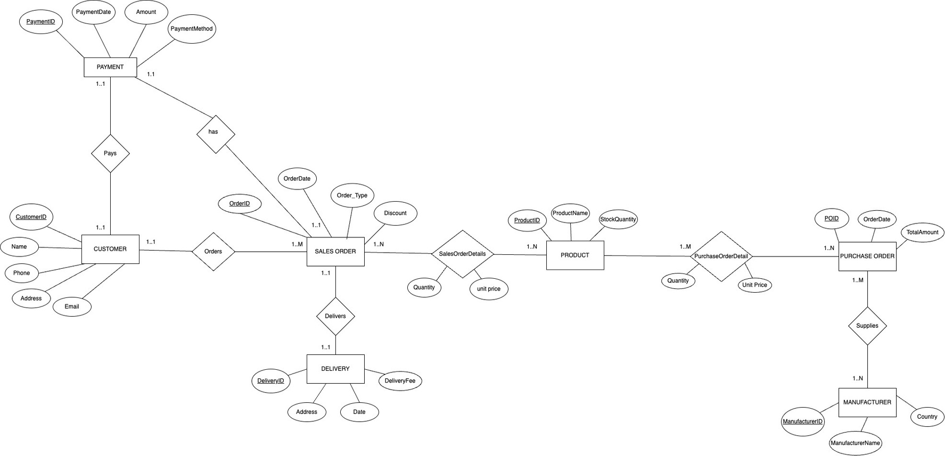
CONCEPTUAL MODELLING
EER DIAGRAM

Slide 5
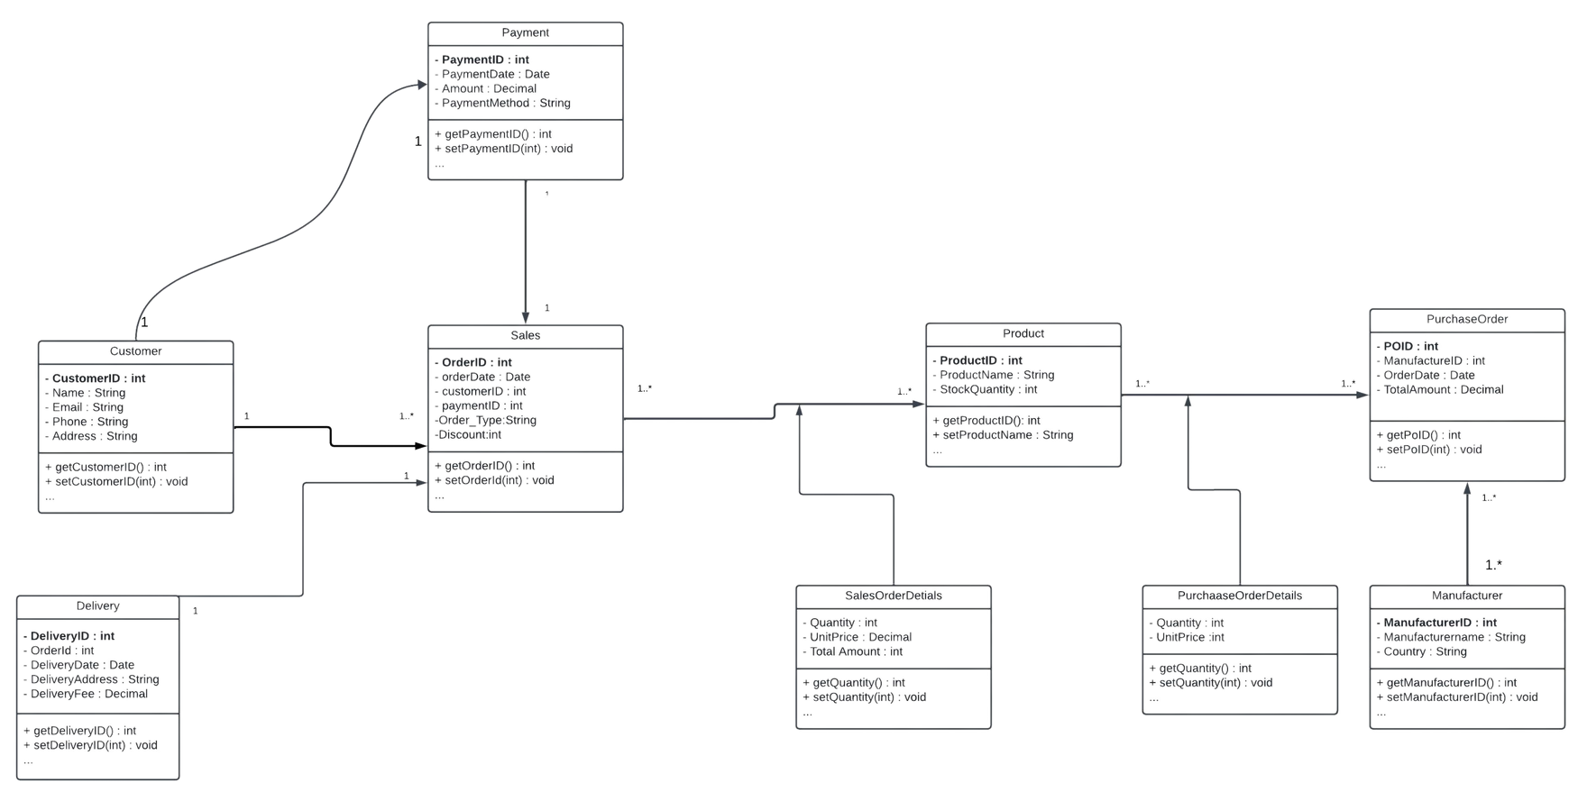
CONCEPTUAL MODELLING
UML CLASS DIAGRAM

Slide 6
RELATIONAL MODEL
1) Customer (c_id, Name, Phone, Address, Email)
2) Payment (Payment_Id, Payment_Date, Amount, Method, c_id)
3) Sales_Order (Order_Id, c_id, Payment_Id, Order_Date, Order_Type, Discount)
4) Delivery (Delivery_Id, Fee, Date, Address, Order_Id)
5) Sales_Order_Detail (Order_Id, Product_Id, Quantity, Unit_Price)
6) Product (Product_Id, P_Name, Stock_Quantity)
7) Purchase_Order_Detail (Product_Id, PO_Id, Unit_Price, Quantity)
8) Purchase_Order (PO_Id, Order_Date, Total_Amount)
9) Manufacture_Purchase_Order(Manufacturer_Id,PO_Id)
10) Manufacturers (Manufacturer_Id, M_Name, M_Address)

Slide 7

IMPLEMENTATION IN MYSQL

Slide 8

IMPLEMENTATION IN NOSQL

Slide 9

INTEGRATION IN PYTHON

Slide 10


THANK YOU
OUR CONTACT
Nishanth Manoharan
manoharan.ni@northeastern.edu
Mohammed Ibrahim
lnu.mohammedib@northeastern.edu

